Slide 1
Final Engagement
Attack, Defense & Analysis of a Vulnerable Network

Slide 2
Table of Contents: Red Team
This document contains the following resources:
Network Topology & Critical Vulnerabilities
Exploits Used
Methods Used to Avoid Detection

Slide 3
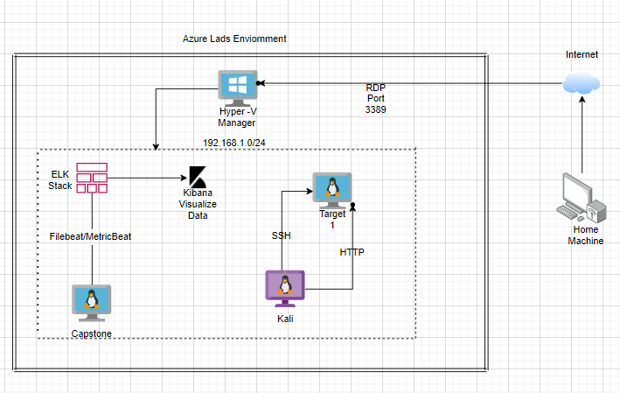
Network Topology
[Insert Here]
Use draw.io to create a diagram of the network.
Add your diagram to this slide and fill out the data in the sidebar.
Network
Address Range:
192.168.1.0/24
Netmask: 255.255.255.0
Gateway:192.168.1.1
Machines
IPv4:192.168.1.90
OS: Dedian kali 5.4.0
Hostname: Kali
IPv4:192.168.1.110
OS: Debian GNU/Linux 8
Hostname:Target 1
IPv4:192.168.1.105
OS:Ubuntu 18.04
Hostname: Capstone
IPv4:192.168.100
OS:Ubuntu 18.04
Hostname: ELK

Slide 4

Network Topology
& Critical Vulnerabilities
‹#›

Slide 5
Critical Vulnerabilities: Target 1
Our assessment uncovered the following critical vulnerabilities in Target 1.
Vulnerability | Description | Impact
Weak Passwords | Easy to manually brute foguess and SSH as Michael | Login as Michael on the Target 1 machine and find flags 1 and 2.
Unsalted SQL credentials | When looking for the MySQL credentials they were easily readable in plaintext | We were able to just login to the SQL database and find flag 3.
Unsalted hashed passwords | Able to find Steven’s password with a simple john crack | Ability to use john the ripper to find Steven’s password from the hashes. (pink84)
Privilege Escalation | When on Target 1we were able to use a python command to escalate to root | Once logged in as Steven we were able to escalate to root using a pseudo-terminal utility.

Slide 6
Exploits Used
‹#›

Slide 7
Exploitation: Weak Passwords
Summarize the following:
Using wpscan we found the usernames Michael and Steven
We used a manual brute force to figure out Michael’s password (michael)
It wasn’t the first password we used, but it was one of them
This allowed us to ssh into the Target 1 machine as Michael and find flags 1 and 2

Slide 8
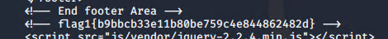
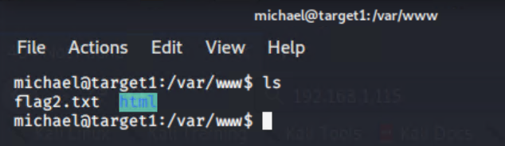

Slide 9
Exploitation: Unsalted MySQL credentials
Summarize the following:
Once logged into the target machine we found the MySQL credentials
Navigated to the wp-config.php and found the unsalted user, password and host
Used the credentials found in .php file to login to the MySQL database
Looked through the tables and found flag 3.

Slide 10
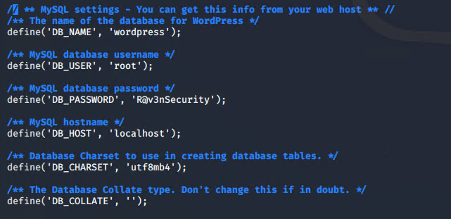

Slide 11
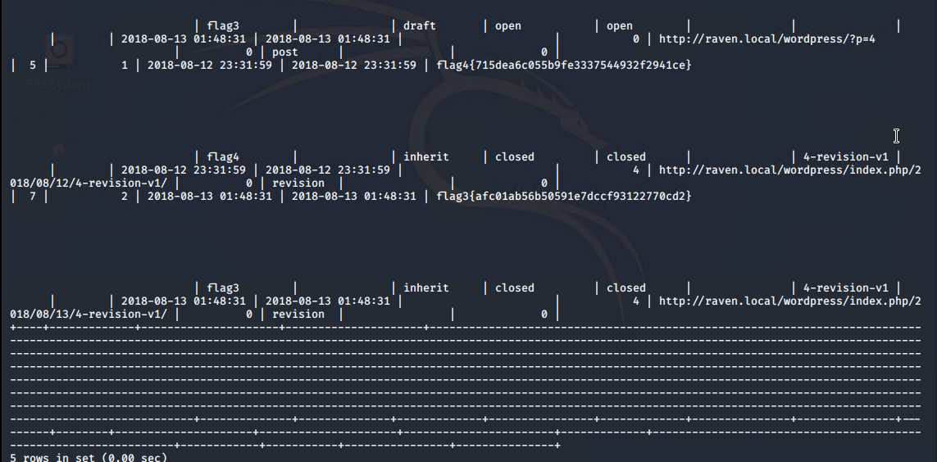

Slide 12
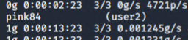
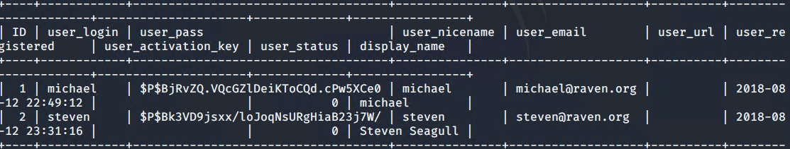
Exploitation: Unsalted Hashed Passwords
Summarize the following:
Once logged on to the MySQL we navigated to the wp_users table and and found the unsalted hashed passwords
Created a .txt file with the hashed passwords and used john the ripper to crack a password

Slide 13
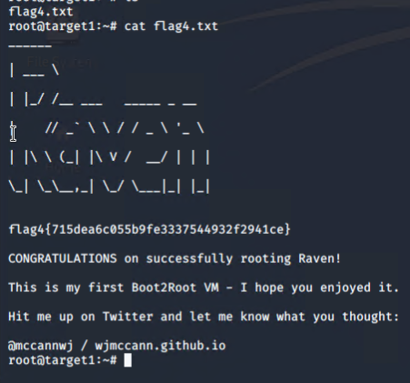

Slide 14
Avoiding Detection
‹#›

Slide 15
Stealth Exploitation of Weak Passwords
Monitoring Overview
Logging in with external IP addresses, or logging of failed login attempts leading up to proper login
Time, IP address, attempts
When HTTP response codes of 400 are recorded more than 5 times in a 5 minute span
Mitigating Detection
Use internal IPs (i.e. SSH into an already exploited machine) and space out login attempts
Phishing techniques to gain more direct access would be more efficient and effective

Slide 16
Stealth Exploitation of Unsalted SQL credentials
Monitoring Overview
External IP addresses and user alerts
Time, IP addresses, usernames, databases accessed
Thresholds could be as low as 1 depending on rules set up for database protection
Mitigating Detection
The best way to mitigate detection would also be with internal IP addresses and/or the use of proper administrative account
Potentially scripting events to gain the administrative access up front might hide tracks easier

Slide 17
Stealth Exploitation of Privilege Escalation
Monitoring Overview
Alert escalation would notify when the escalation to root occurs.
The alert is triggered any time user escalates privileges to root,
They fire each time root user is accesses
Mitigating Detection
You cannot use this exploit undetected because of all of the alerts going off
An alternative exploit would be to find the root password a different way.

Slide 18
Network Topology
& Critical Vulnerabilities
‹#›

Slide 19
Table of Contents : Network Analysis
This document contains the following resources:
Network Topology & Critical Vulnerabilities
Traffic Profile
Normal Activity
Malicious Activity

Slide 20
Critical Vulnerabilities: Target 1
Our assessment uncovered the following critical vulnerabilities in Target 1.
Vulnerability | Description | Impact
Weak Passwords | Was able to find passwords using dictionary brute force against web form | Allowed attacker to gain access to protected web directories
Wordpress User Enumeration | Utilized enum4linux to gather user information for the web server | Allows attacker to gather usernames to gain access to the web server
Unprotected and Unsalted Hash | Used Rainbow table to compare an unprotected hash to a corresponding password | Allowed attacker to gain access to WebDav to alter contents of web server
Privilege Escalation | Used Stevens sudo Python access to escalate from ‘Steven to root’ | Allowed privilege escalation to root

Slide 21
Traffic Profile
‹#›

Slide 22
Traffic Profile
Our analysis identified the following characteristics of the traffic on the network:
Feature | Value | Description
Top Talkers (IP Addresses) | 172.16.4.205, 185.243.115.84, 166.62.111.64 | Machines that sent the most traffic.
Most Common Protocols | VSS Monitoring Ethernet trailer, HTTP, (TLS) | Three most common protocols on the network.
# of Unique IP Addresses | 808 | Count of observed IP addresses.
Subnets | 24-bit block | Observed subnet ranges.
# of Malware Species | Trojan (june11.dll) | Number of malware binaries identified in traffic.
Notes:
You may have more than 2 subnets.

Slide 23
Behavioral Analysis
Purpose of Traffic on the Network
Users were observed engaging in the following kinds of activity.
“Normal” Activity
For example: Watching YouTube, reading the news.
Normal use of the website via wordpress traffic
Standard files transferred (Favicons, standard scripts, supporting images)
Application Programming Interfaces (APIs) necessary to support the browser-site interaction
Suspicious Activity
For example: Sending malware, phishing.
files.publicdomaintorrents.com used to download “Betty_Boop_Rhythm_on_the_Reservation.avi.torrent”
http://205.185.125.104/files/june11.dll
b5689023.green.mattingsolutions.co downloaded empty.gif?ss&ss1img

Slide 24
Normal Activity
‹#›

Slide 25
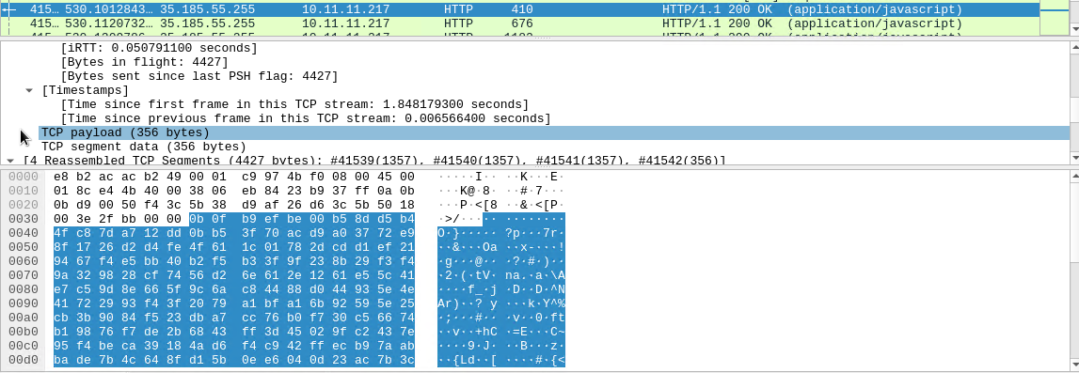
Standard Website Traffic
Summarize the following:
Protocols observed:
TCP
HTTP
Traffic Analyzed:
www.sabethahospital.com
www.iphonehacks.com
mysocalledchaos.com
Possibly Interesting Files:
jquery-migrate.min.js

Slide 26
Malicious Activity
‹#›

Slide 27
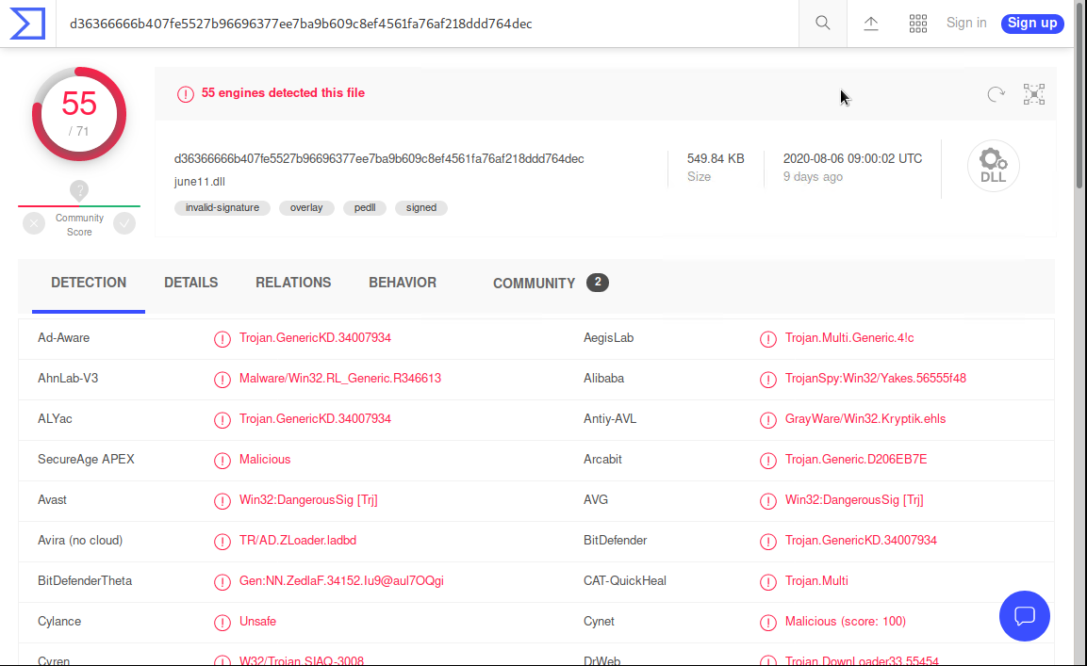
Illegal Downloads
Summarize the following:
Protocol Observed:
HTTP
Traffic Analyzed:
User downloaded a Trojan from http://205.185.125.104/files/june11.dll
Possibly Interesting Files:
june11.dll

Slide 28
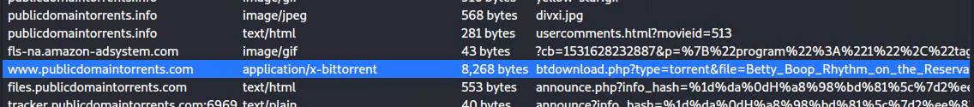
Illegal Downloads
Summarize the following:
Protocol Observed:
HTTP
Traffic Analyzed:
User was browsing publicdomaintorrents.com and downloaded a torrent.
Possibly Interesting Files:
Betty_Boop_Rhythm_on_the_Reservation.avi.torrent

Slide 29
Fin
‹#›

